Slide 1



From RAGs to Riches: Utilizing Richly Attributed Graphs to Reason from Heterogeneous Data
PI: Joshua Vogelstein
Johns Hopkins University
SIMPLEX Monthly Progress Report
[Aug 1, 2015 – Aug 31, 2015]

Slide 2
Technical Executive Overview
Technical Accomplishments
RAG Embedding (Tensor Factorization): benchmarked FlashMatrix eigensolver against competitors, we are better :)
Data Management (Dense Arrays): benchmarked NeuroBlaze against OCP, several factor speedup
Data Ingest (Diffusion MRI): processing 20 additional datasets to obtain over 2000 new DTI derived brain graphs
RAG Construct (Random Walks): Developed new RAG generative model and inference technique that significantly outperform previous joint embedding strategies
Other Organizational Updates
Created umbrella organization called NeuroData, to emphasis more generality over merely connectomes at a single scale
Launched new website http://neurodata.io, is live, will be fully operational shortly

Slide 3
RAG Embedding – Tensor Factorization
Benchmarking against other in-memory and some distributed memory eigensolvers
began exploring possible NMF implementations to backend
singular values | residual
10563 | 4.067819E-13
10442 | 1.044935E-13
9531 | 2.527054E-13
7905 | 9.656768E-14

Slide 4
Data Management - Dense Arrays
continuous progress on speeding up and benchmarking
code: https://github.com/openconnectome/ocpblaze
Premlinary Timings | OCP | Blaze
512x512x16 | 0.478 | 0.171
1024x1024x16 | 1.699 | 0.709
2048x2048x16 | 6.696 | 2.612
4096x4096x16 | 24.919 | 8.87

Slide 5
Data Management - Sparse Arrays
Began exploring surface compression
Began exploring surface visualization
Began exploring a surface database

Slide 6
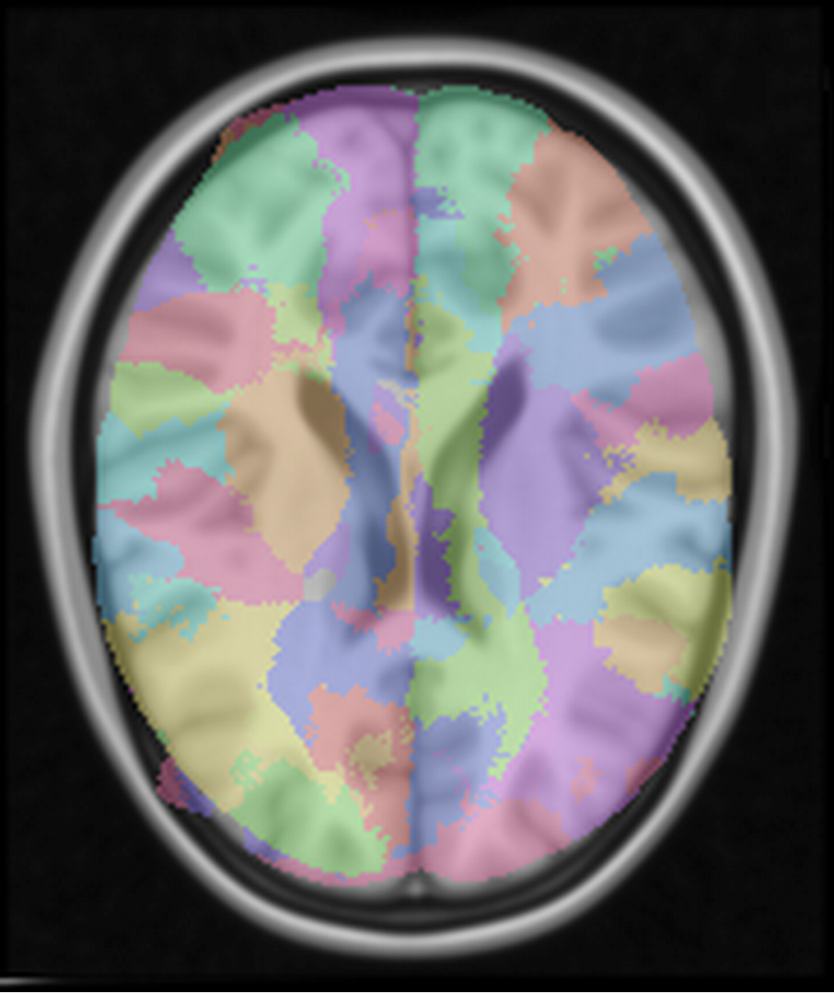
Data Ingest - Diffusion MRI
Ran our first pediatric brain via Web-service
Feedback: “Again, I think your program will revolutionize the way we do research"
Running all data from the CoRR dataset
Deploying AMI to enable others to modify and run ad will
http://dsp061.pha.jhu.edu/ocp/overlay/0.4/dsp061.pha.jhu.edu/mniatlas/desikan/dsp061.pha.jhu.edu/mniatlas/image/xy/0/0,182/0,218/91/

Slide 7
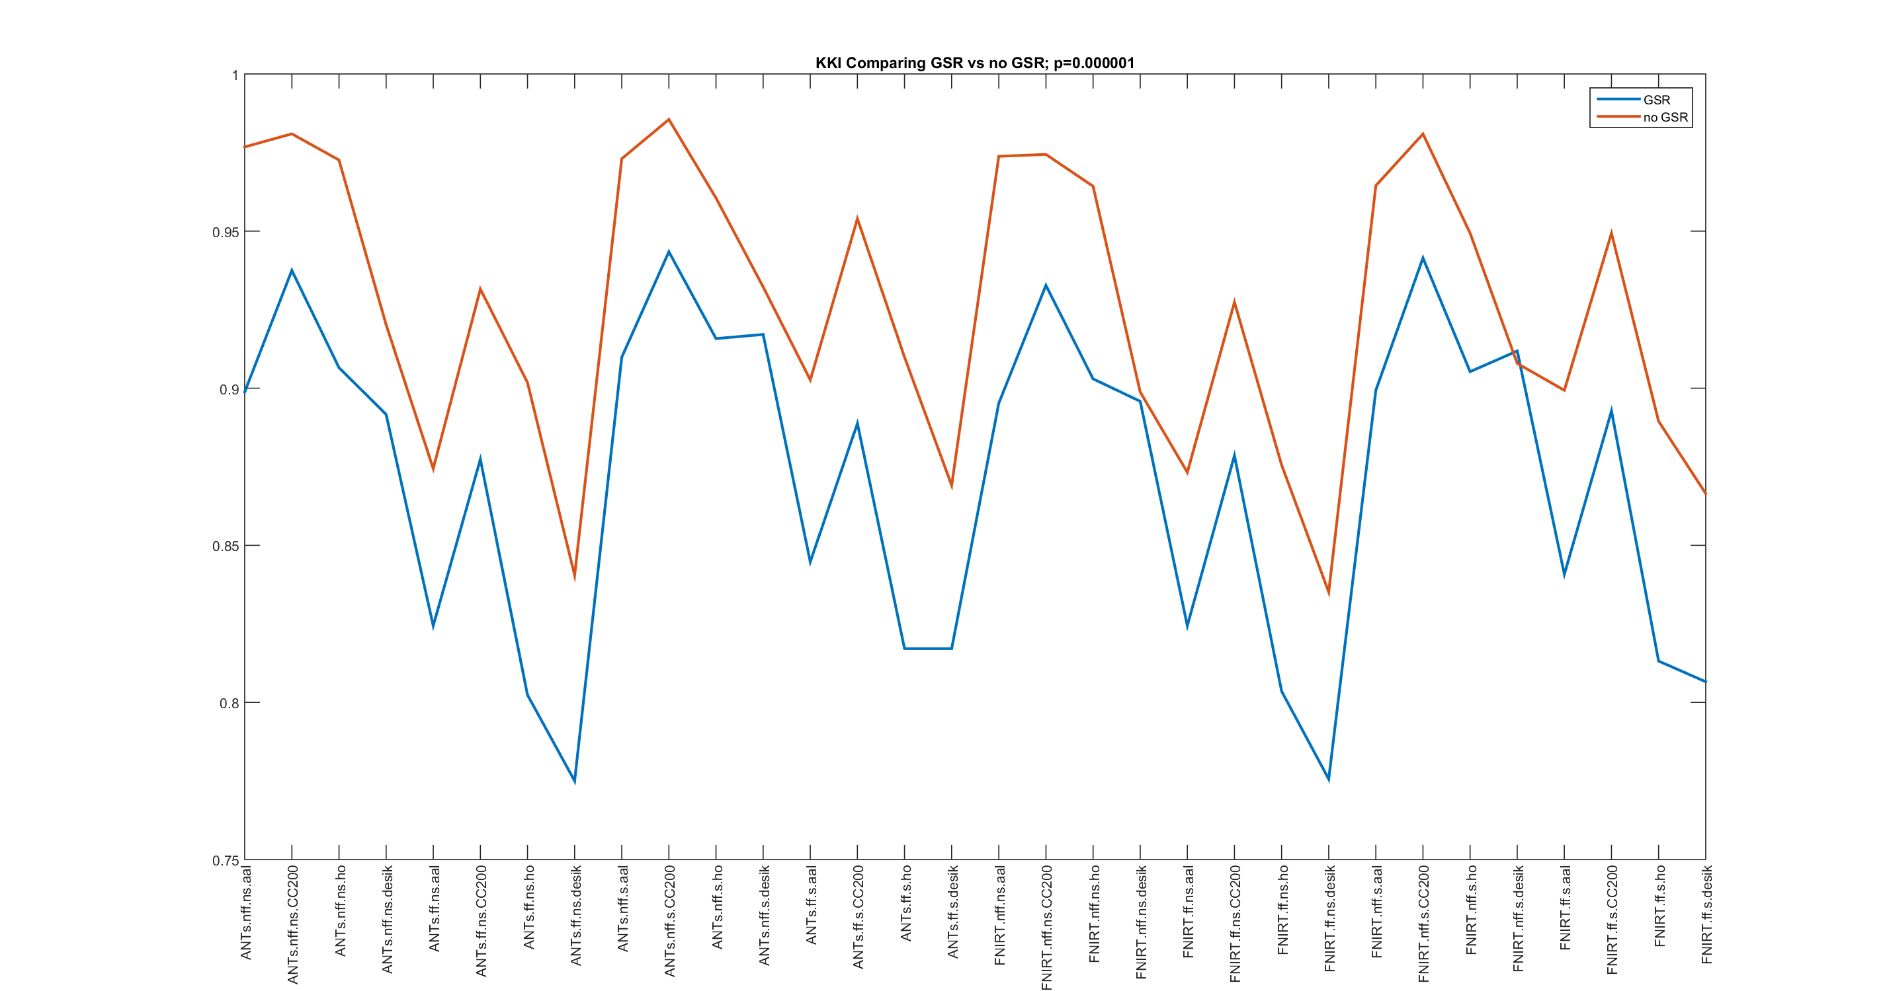
Data Ingest - functional MRI
Ran 64 different pipelines on 4 different datasets
Collecting the results now
There are steps that, so far, clearly are superior although historically have been thought inferior

Slide 8
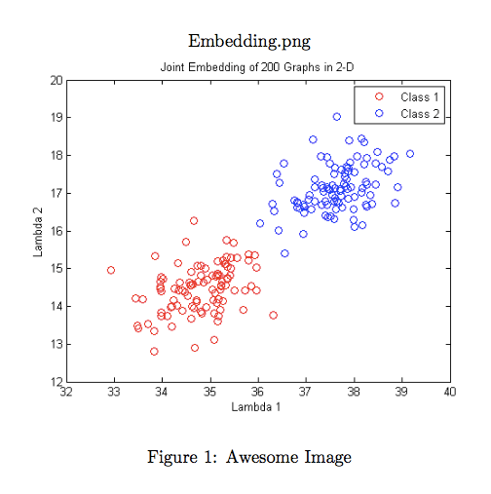
RAG Construction
Novel RAG generative model
Novel inference algorithm motivated by generative model
Under a simple simulation, new method achieves optimal performance, old methods achieve 86% or 28%

Slide 9
Potential Next Steps
RAG Embedding
Tensor Factorization: backend NMF
Data Management
Dense Arrays: continue developing NeuroBlaze to v0.1
Sparse Arrays: add functionality to query & visualize surfaces
Data Ingest
Diffusion MRI - ingest several benchmark datasets
functional MRI - ingest fMRI data as a separate channel for each subject
RAG Construct
Continue testing/exploring new model and inference method

Slide 10
Software Development
Software
FlashGraph: https://github.com/icoming/FlashGraph
NeuroBlaze: https://github.com/openconnectome/ocpblaze
NeuroSurf: https://github.com/openconnectome/surface-extractor

Slide 11
Programmatic challenges and requests for PM action
Key challenges and/or associated risk:
For RAG construction,we have devised a novel model and inference method, which has compelling preliminary results, and requires significant additional theoretical and numerical analysis.
Request for action:
No action requested.

